Slide 1
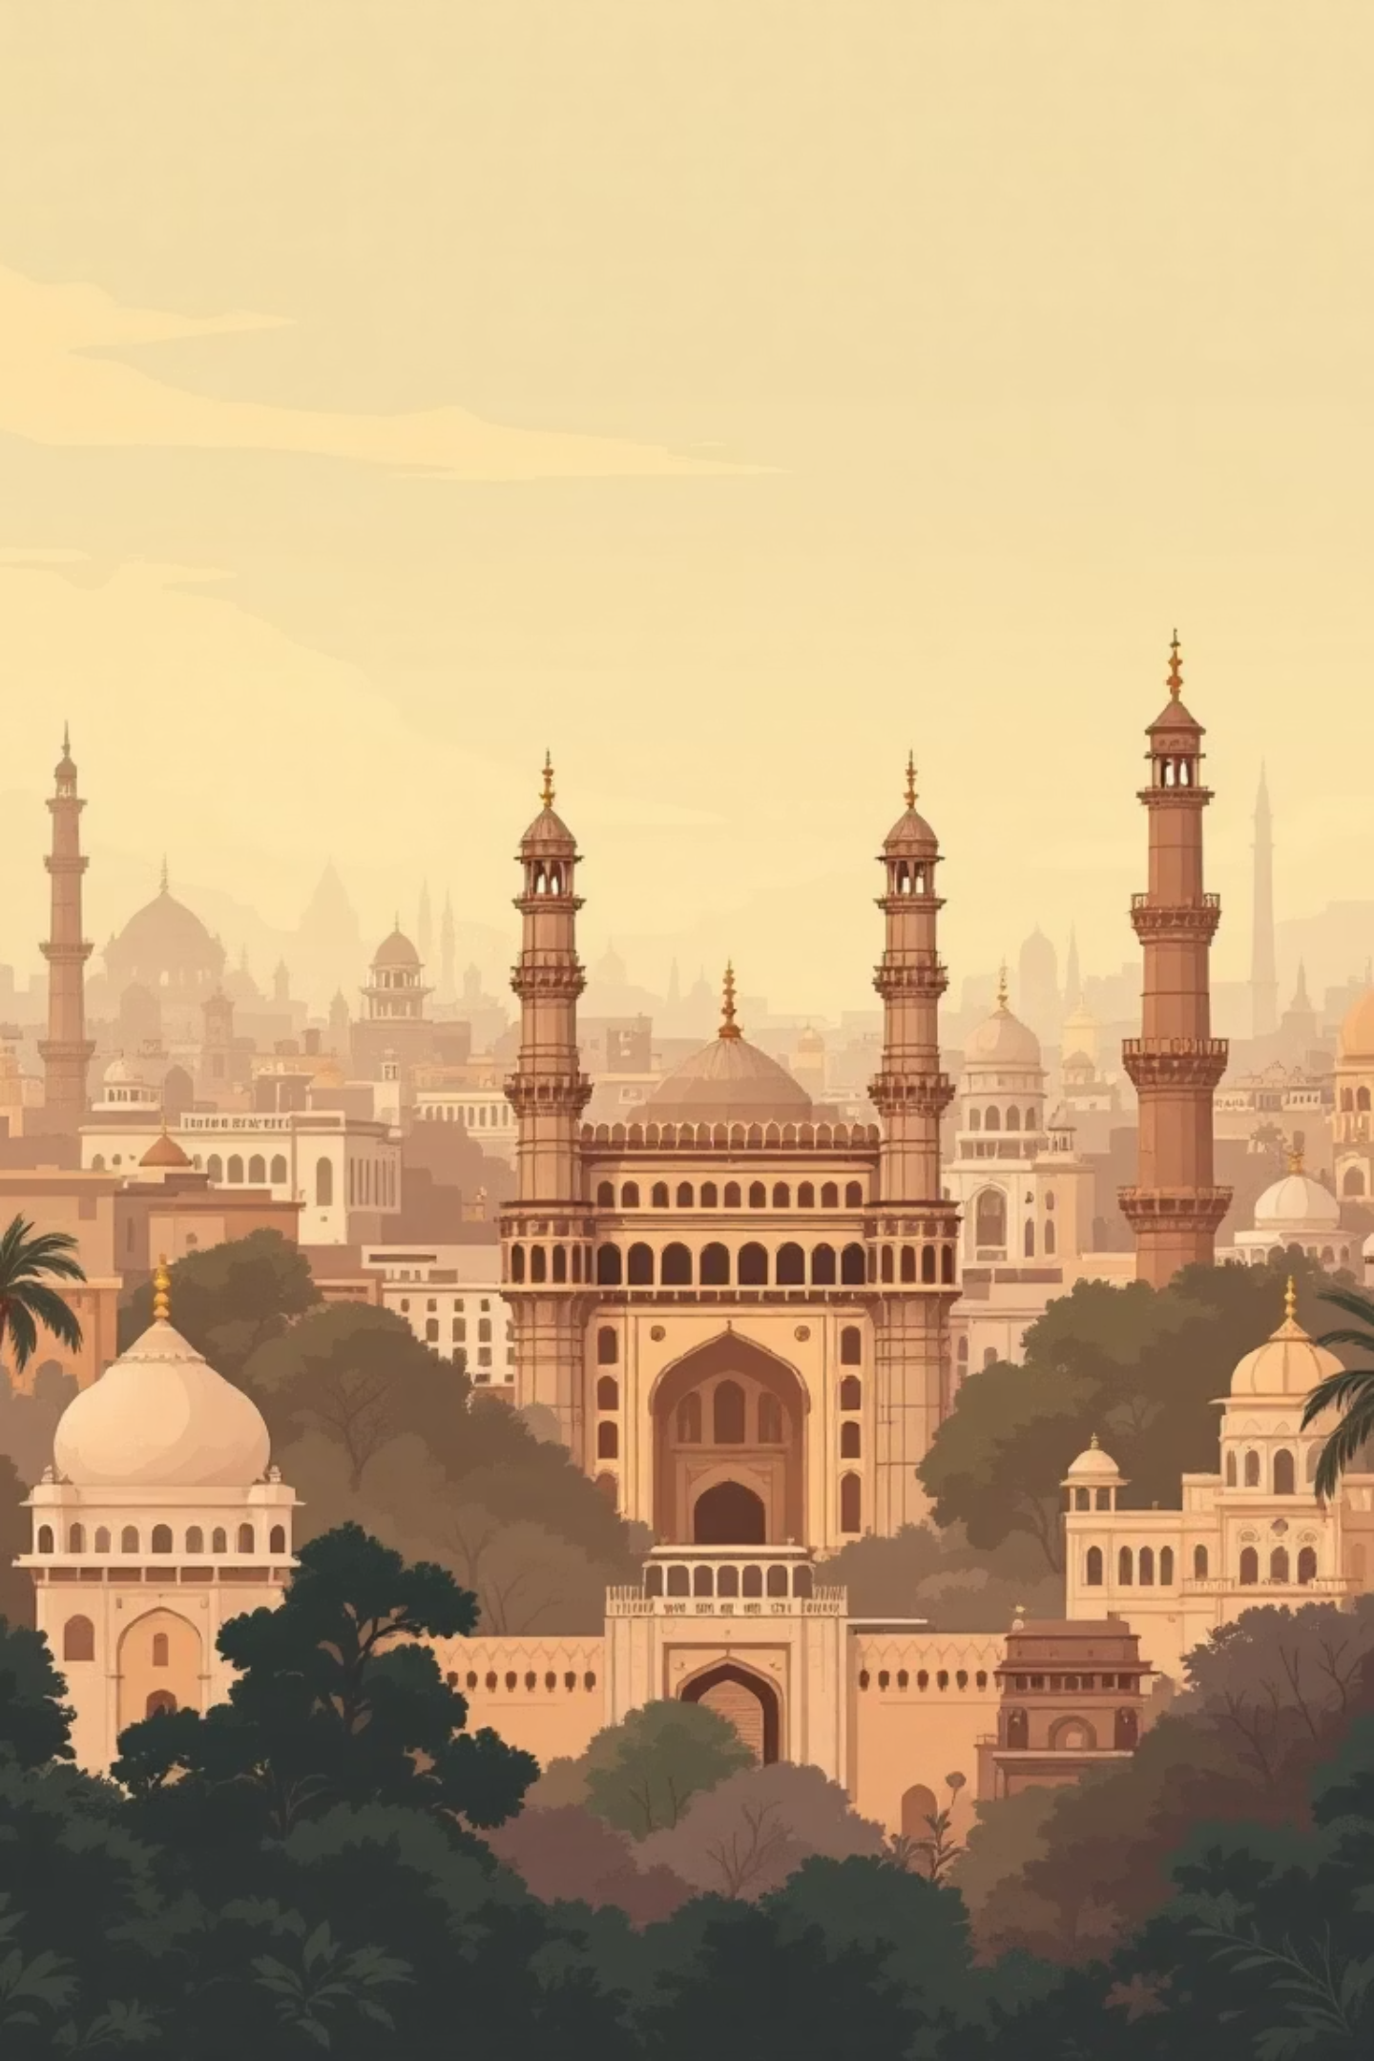

HydeGraph - Cultural Network Recommenders for Hyderabad
Rudra Choudhary (Roll No: 2024121012)
Saiyam Jain (Roll No: 2023101135)
Sohan Thummala (Roll No: 2023101019)

Slide 2
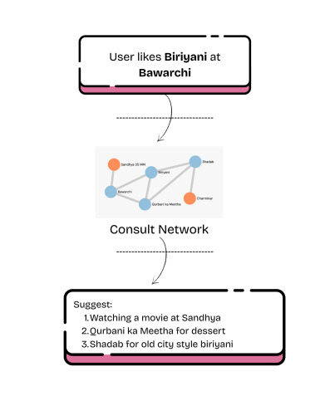
Motivation & Objectives
The Goal
Our Solution
The goal of this project is to develop a graph-based recommender system that captures and highlights the rich cultural landscape of Hyderabad, including its monuments, heritage sites, and iconic food traditions. The system aims to provide meaningful, culturally grounded connections between these entities through a structured network representation.
We built a system with three key components:
Word-Occurrence Network:Scraped web text to build a co-occurrence graph linking cultural entities.
Entity Mapping:Converted free-form user text into recognized cultural entities.
Recommendation Engine:Used graph relationships to provide direct, exploratory, and guided recommendations.

Slide 3
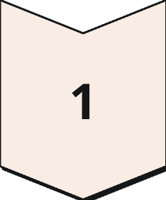
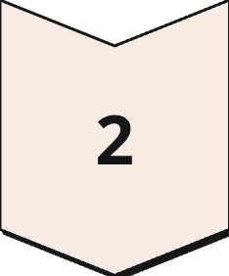
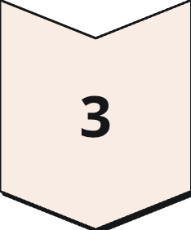
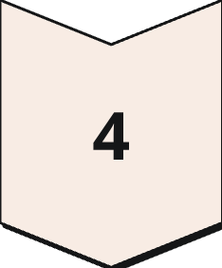
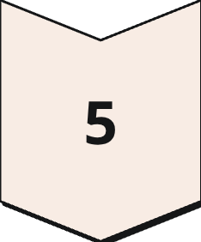
System Overview
Our end-to-end pipeline transforms user queries into rich, visual recommendations through five integrated steps.
Free-Text Input
User enters natural language query
Named Entity Recognition
spaCy with fallback matching
Entity Matching
Map to NetworkX graph nodes
Run Network based Recommenders
Apply algorithm suite
Visual Dashboard
Display results and paths

Slide 4
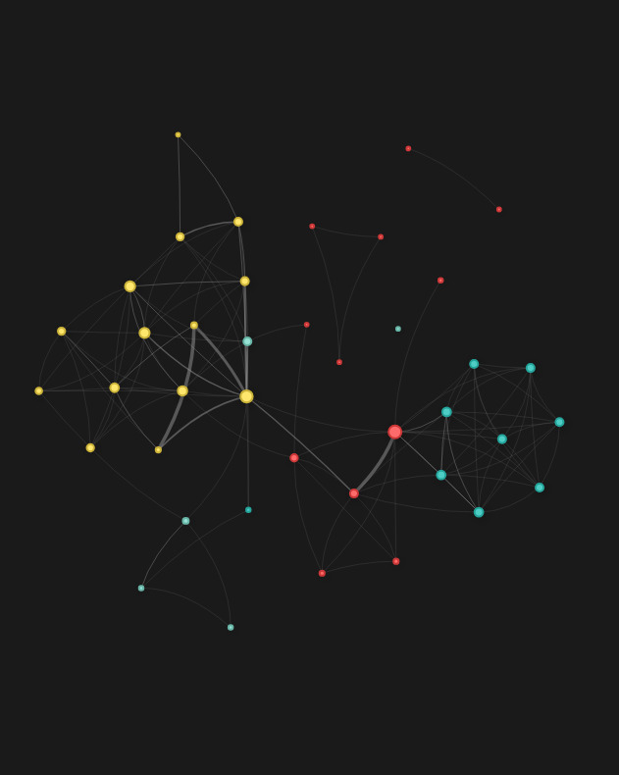
Data & Graph Construction
Corpus Details
Our knowledge base consists of scraped sentence/paragraph/Page -level content capturing Hyderabad's cultural entities.
Nodes: Places, food items, people, and organizations identified through NER and corpus matching.
Edges: Co-occurrence relationships within sentences, weighted by frequency count.

Slide 5
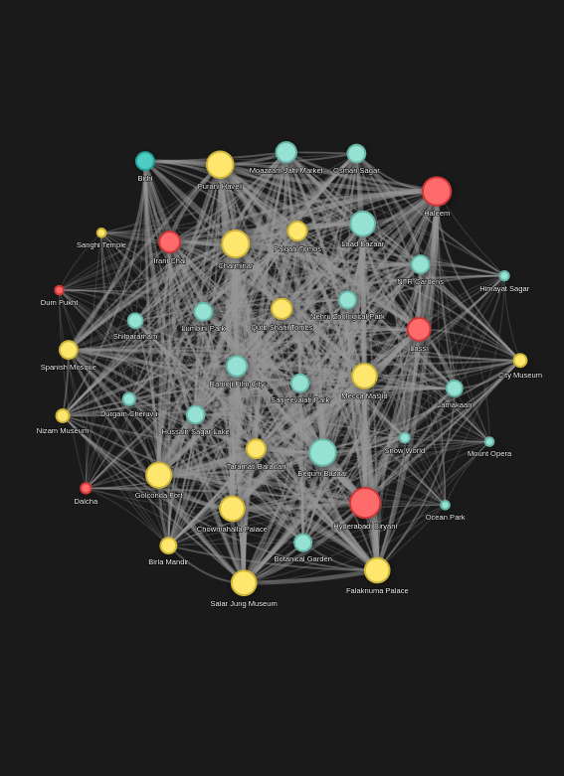
Named Entity Recognition & Matching
Converting user query into graph corresponding entities requires robust NER with intelligent fallback mechanisms.
01
spaCy NER Processing
Tokenizes input and labels entities: places, people, organizations, and food items. Serves as the primary entity extraction tool.
02
Entity Matching
Maps recognized entities to graph nodes using exact string matching against the knowledge base.
03
Fallback Strategies
Handles NER misses through exact-text and substring matching, improving recall for single-word inputs and case variations like "Charminar".
04

Slide 6
Recommenders Overview
We developed seven distinct recommender algorithms, each optimized for different user needs and exploration styles.
Local/Deterministic
Centrality-Based
Discriminative
Simple Co Occurence Recommender
PageRank Recommender
Inverse Frequency Recommender
Fast, explainable direct associations
Global context and importance-aware
Favors distinctive, specific entities
Exploratory/Stochastic
Goal-Directed
Random Walk & Exploratory Walk
Guided Walk & Guided Exploratory
Serendipitous discovery with relevance
Thematic journeys with destinations

Slide 7
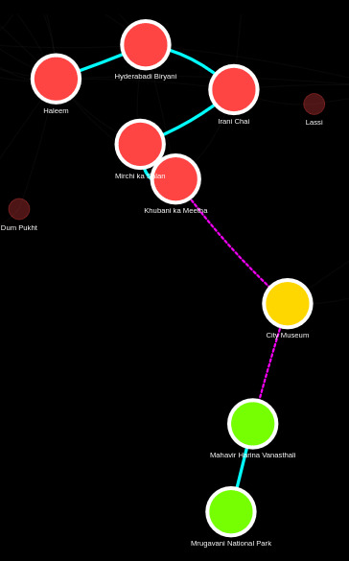
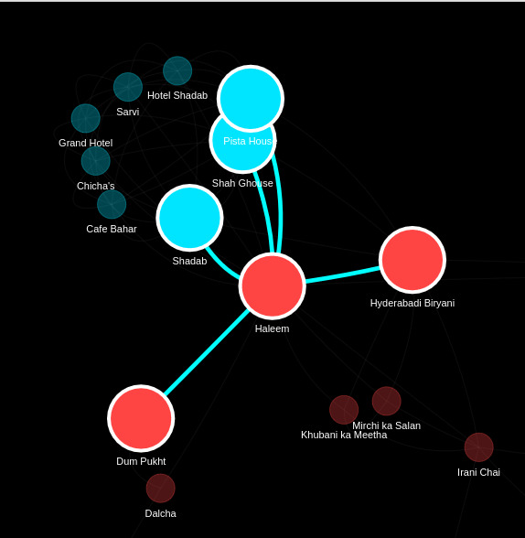
Algorithm Details: Part A
1
Simple Co-Occurrence Recommender
Returns top neighbors ranked by co-occurrence weight. Fastest option providing direct, explainable associations. Ideal for users seeking immediate cultural connections.
Example: "Charminar" → Laad Bazaar, Mecca Masjid
2
PageRank Recommender
Applies personalized PageRank biased toward seed entities, capturing indirect connections and central nodes. Leverages global graph structure to identify culturally important entities.
Example: Surfaces influential landmarks beyond immediate neighbors
3
Inverse Frequency Recommender
Weights neighbors by edge weight multiplied by IDF score, favoring distinctive over generic entities. Reduces common, less informative results.
Example: Prioritizes unique cultural items over ubiquitous mentions
4
Random Walk Recommender
Executes multiple stochastic walks, collecting visit frequencies. Yields serendipitous yet relevant discoveries through probabilistic exploration.
Example: Uncovers unexpected cultural connections

Slide 8
Algorithm Details: Part B
Goal-directed and hybrid approaches enable thematic journeys through Hyderabad's cultural landscape.
Guided Walk Recommender
1
Uses Dijkstra-based pathfinding to maximize cumulative cultural connection between start and end points. Returns ordered itinerary optimizing for meaningful transitions.
2
Exploratory Walk Recommender
Random walk with small teleportation probability, balancing local context with global serendipity. Prevents getting trapped in dense local clusters.
Best for: Start → end recommendations with clear destinations
Best for: Open-ended exploration with occasional surprises
Guided Exploratory Walk
3
Bias-random-walk toward destination using proximity scoring. Produces engaging, thematic journeys that feel both purposeful and surprising.
Best for: Balanced exploration with directional guidance

Slide 9
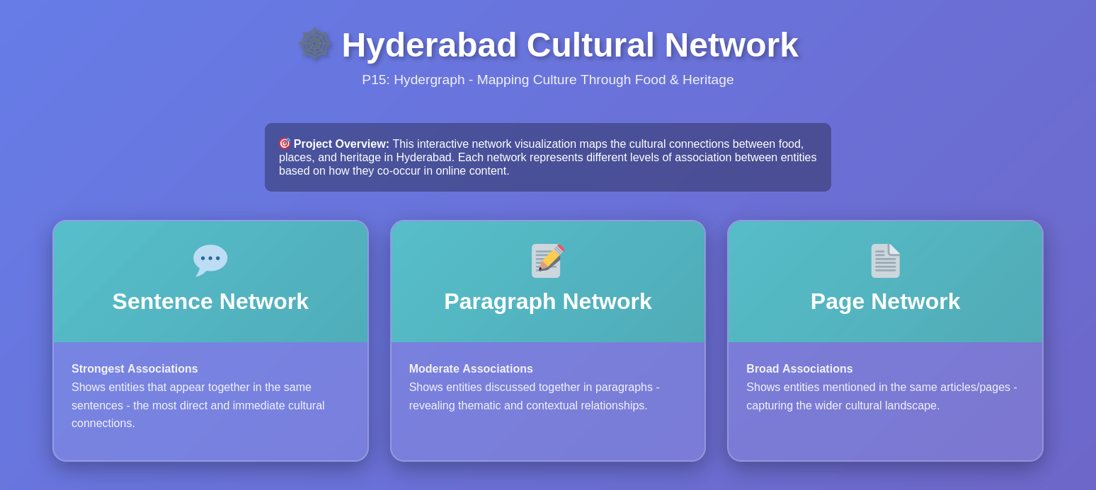
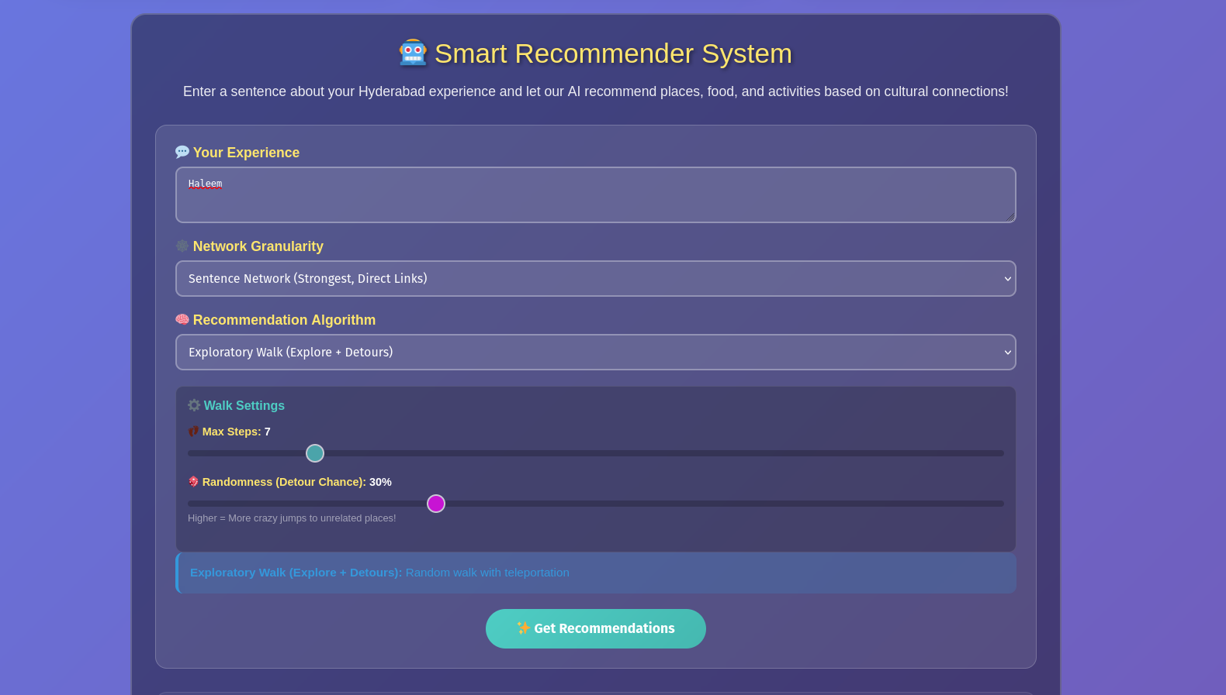
Dashboard & User
Interaction.
Example Flow
Key Interface Elements
Search box: Free-text input for natural queries
Query: "Charminar"
Simple Recommender:
Network view: Highlighted graph with weighted edges
Laad Bazaar (weight: 45)
Recommendation pane: Ranked results with explanations
Irani Chai (weight: 38)
Osmania Biscuits (weight: 32)
Path overlay: Visual itinerary on network
Guided Path:
Explanation badges: "Why recommended" justifications
Charminar → Mecca Masjid → Laad Bazaar → Lumbini Park
Each step includes edge weight and cultural connection explanation, building user trust through transparency.

Slide 10
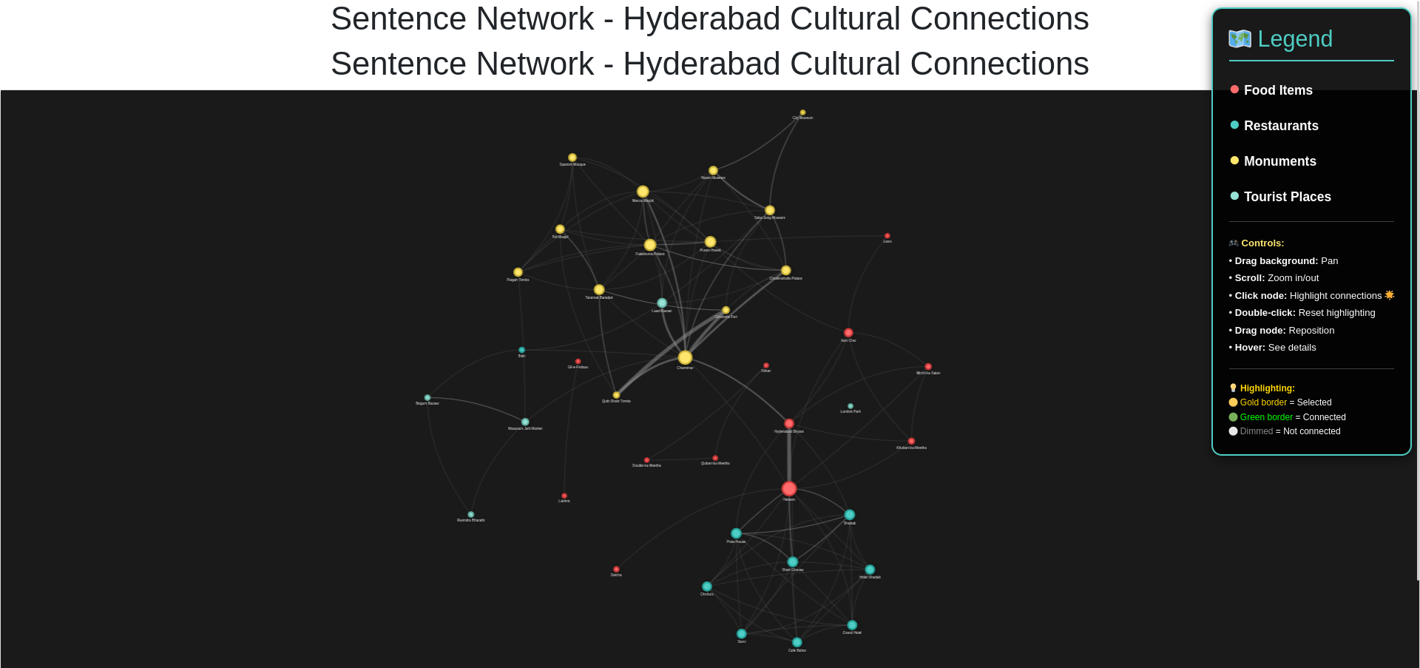
HydeGraph Dashboard

Slide 11
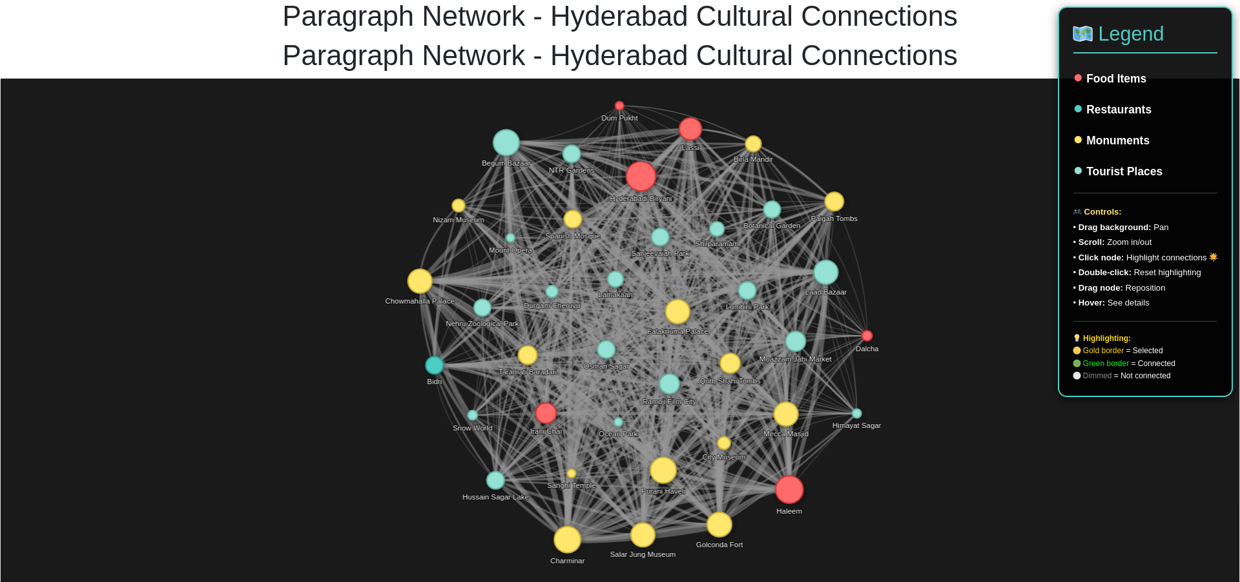
HydeGraph Dashboard

Slide 12
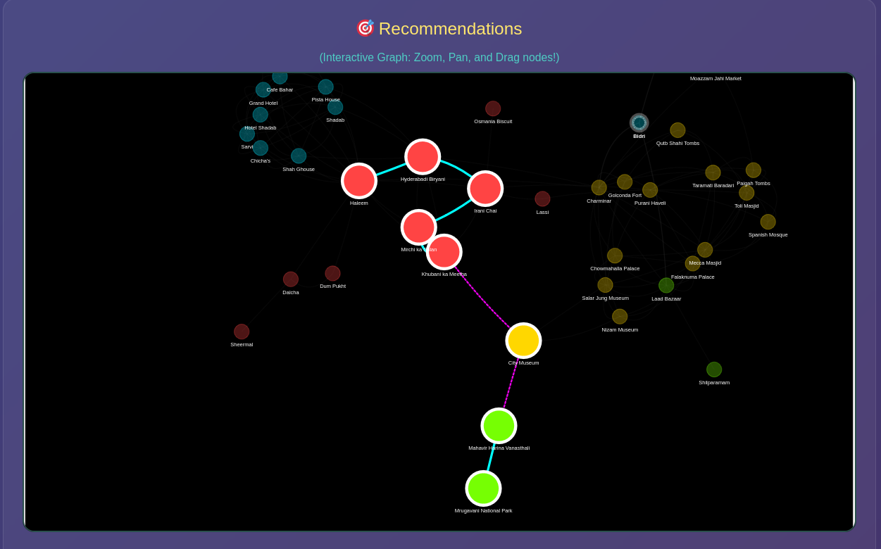
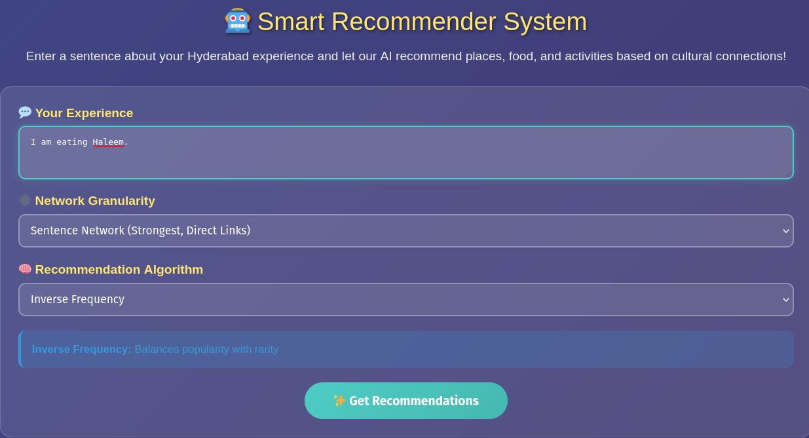
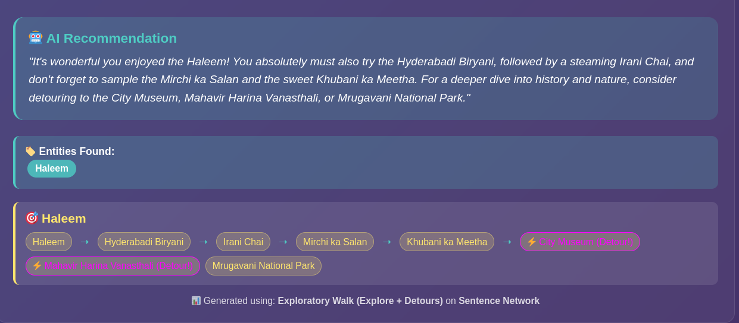
HydeGraph Dashboard

Slide 13

Now, let's dive into the ACTUAL DEMO !

